Slide 1

CodeVerse
Round 1: Idea Pitch - Presentation

Slide 2
Team Introduction
- Team Name: Jaadu
- Team Members: (Name, College)
-> (Vaibhav Mishra, VIT Bhopal)
-> (Nabh Garg, VIT Bhopal)
-> (Gauravendra Dev Tripathi, VIT Bhopal)
-> (Shikhar Sharma, VIT Bhopal)
- Contact Details of Team Lead
-> Ph. No: 9911393774
-> Mail ID: rvr.vaibhavmishra@gmail.com

Slide 3

Problem Statement
- What real-world problem are you addressing?
- Why is this problem significant?

Slide 4
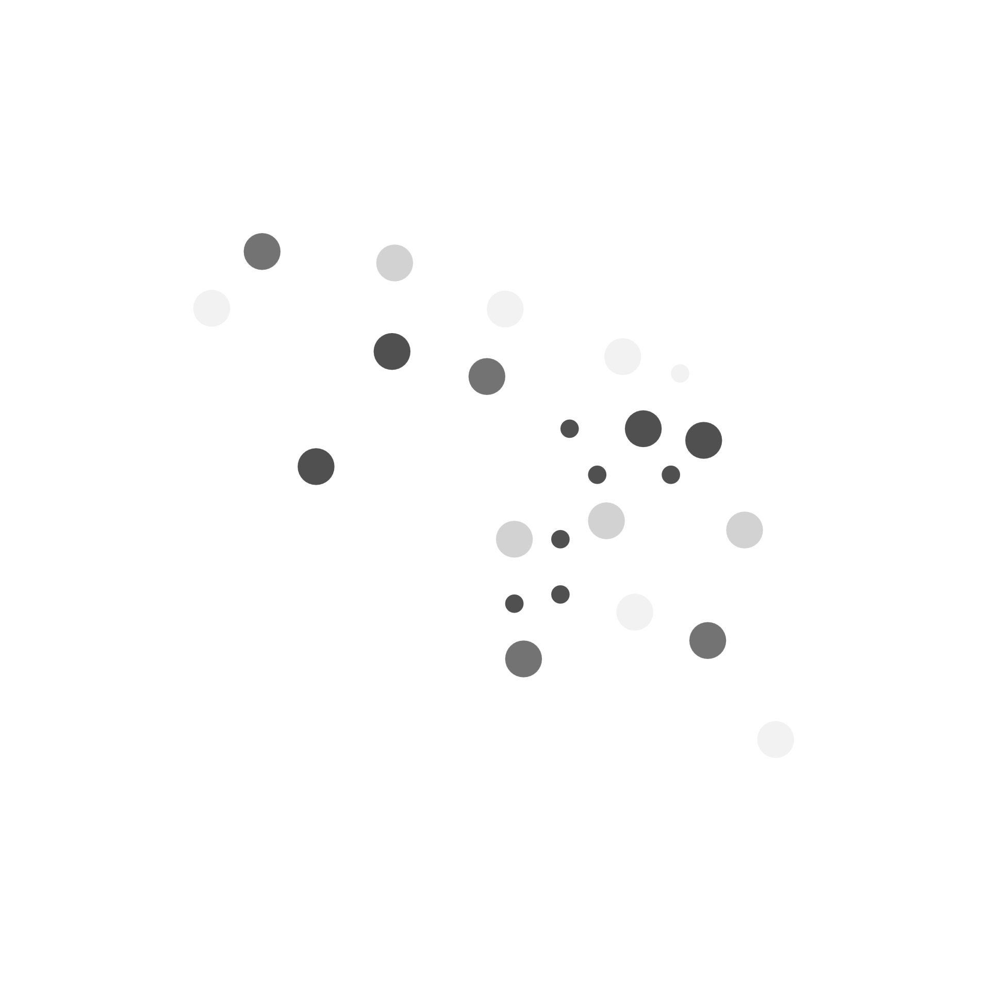

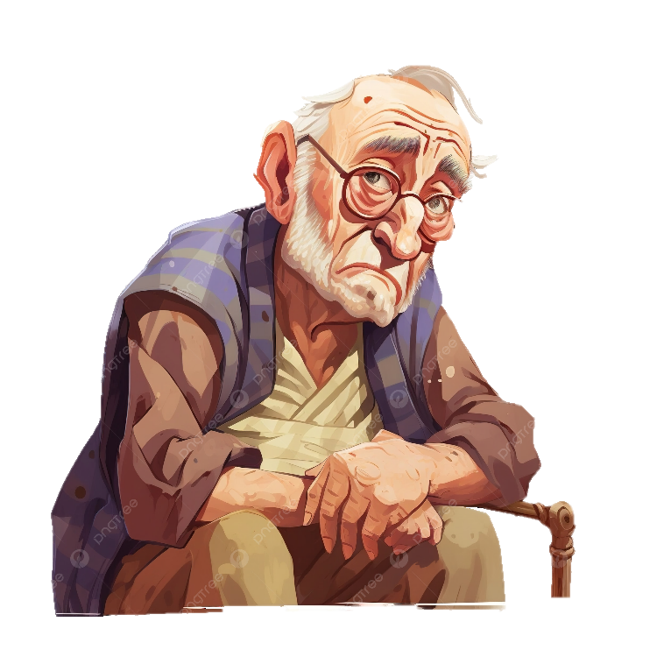
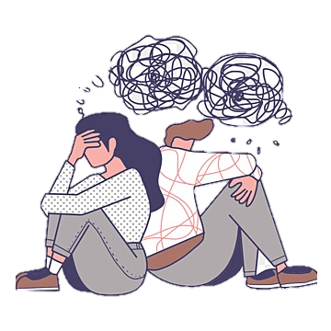
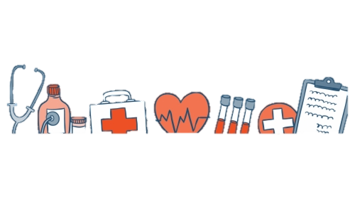
Problem Statement
- What real-world problem are you addressing?
We are addressing the lack of a unified, accessible, and intelligent health management system that helps all individuals — especially the elderly and those living independently — to proactively manage their health, adhere to treatments, and receive timely care.
In today’s fast-paced world, people often:
Forget to take medications or miss health appointments
Delay routine checkups or ignore minor symptoms until it’s too late
Struggle to track vitals like BP, oxygen, or sugar levels consistently
Live alone with no system in place to detect accidents like falls
Fail to get immediate help in emergencies due to poor connectivity or lack of support systems
“Even though multiple apps and devices exist, they often operate in isolation — leading to inefficiencies and fragmented healthcare experiences.”

Slide 5
Problem Statement
- Why is this problem significant?
1. Unnoticed Health Emergencies
Falls, abnormal vitals, or delayed care — especially in night hours — often go unnoticed, risking permanent damage or death, particularly among seniors and those living alone.
2. Low Medication Adherence
Nearly 1 in 2 patients skip or forget medications globally. In India, reasons include poor app usability, forgetfulness, and low awareness — increasing relapse rates and emergency visits.
3. Lack of Real-Time Monitoring
Caregivers and family often have no structured way to track someone's health remotely — vitals, appointments, or falls go unreported until it’s too late.
4. Fragmented, Unfriendly Interfaces
Users rely on multiple disconnected apps — for reminders, doctor access, hospitals, and vitals. Most apps are bloated, confusing, and not senior-friendly.
5. Mental Health Impact & Isolation
The elderly and chronically ill face anxiety, helplessness, and loneliness — with no dependable, everyday companion for proactive health support.
6. Affordability & Accessibility Gaps
Premium health tracking solutions are too expensive, and free ones lack depth or ease-of-use. There’s a clear gap for a unified, affordable, web-based platform that works across devices — including smartphones and PCs — without requiring smartwatches or costly subscriptions.
In summary: We’re addressing a crucial gap at the intersection of health, affordability, independence, and technology — with a solution built for everyone, and a focus on inclusivity for seniors and caregivers, without compromising usability or cost.

Slide 6
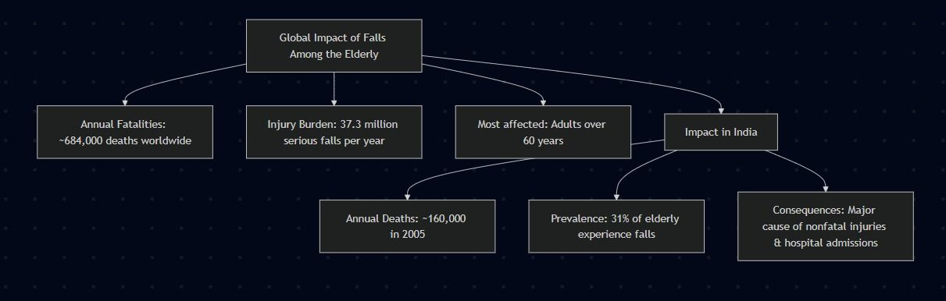
Problem Statement
Facts – Data – Figures
1. Anecdotal Examples
An 82-year-old woman living alone in Delhi fell in her bathroom and was found unconscious after 6 hours.
A 70-year-old man in rural Tamil Nadu fell during early morning chores but couldn’t alert family due to lack of support.
These stories highlight the dangers of unnoticed falls among the elderly.
2. Economic & Social Impact
Hospitalization Costs: Treating a hip fracture in India costs around ₹80,000–₹1,50,000.
Caregiver Burden: Families often miss work or pay for full-time care.
Loss of Independence: Falls can cause permanent disability or fear, reducing mobility and harming mental health.

Slide 7
Problem Statement
REAL LIFE INCIDENTS
🧓 Mr. Ravi (72, Mumbai) — Unnoticed Fall
Mr. Ravi, living alone, fell in his bathroom and was unconscious for over 6 hours before being found. This delay caused a mild stroke, and now he needs assisted care.
Insight: A fall detection device could have alerted his family immediately. Reference: Times of India
👵 Mrs. Leela (68, Chennai) — Early Intervention
Mrs. Leela’s fall alert device detected a fall and alerted her son. Help arrived in 10 minutes, preventing serious injury.
Insight: Technology enables timely help and avoids major health issues. Reference: The Hindu
🧓 Mr. Arvind (80, Lucknow) — Missed Heart Rate Alert
Mr. Arvind fainted due to a sudden heart rate drop without monitoring and suffered a head injury. Hospital reports said early detection could have prevented this.
Insight: Continuous health monitoring can prevent falls and hospitalization. Reference: Hindustan Times
👵 Mrs. Rekha (75, Pune) — Psychological Impact
After a serious fall, Mrs. Rekha stopped walking independently due to fear, leading to depression and reduced mobility.
Insight: Fall prevention systems restore safety and confidence. Reference: DNA India

Slide 8
Proposed Solution
- Overview of your solution
- Key features and functionalities
- What makes your solution unique?

Slide 9
Proposed Solution
- Overview of your solution
Our project named ‘EASY’, aims to build a comprehensive and affordable digital health assistant, accessible through a responsive web application and optionally enhanced with a smart IoT device. It helps individuals—especially the elderly, chronically ill, or those living independently—monitor vitals, manage medications, track appointments, and stay connected with care providers, all in one place.
Key points:
📦 Hardware Extension (Planned): A compact IoT container with an accelerometer, heartbeat sensor, and temperature sensor for passive health monitoring to provide real-time data collection, such as detecting abnormal readings or falls.
💻 Web-Based & Platform Web-App: No installation required. Accessible on mobile, tablets, and desktop for broader reach.
🩺 Centralized Health Hub: Manage medications, log incidents, and connect with doctors and caregivers in one place. Focus from medication reminders to vital monitoring, with an intuitive interface for even non-tech-savvy users.
.
💡 Affordable & Scalable: Designed with low-cost deployment in mind. Emphasis on scalability, and real-world applicability, especially for semi-urban/rural or aging populations.

Slide 10
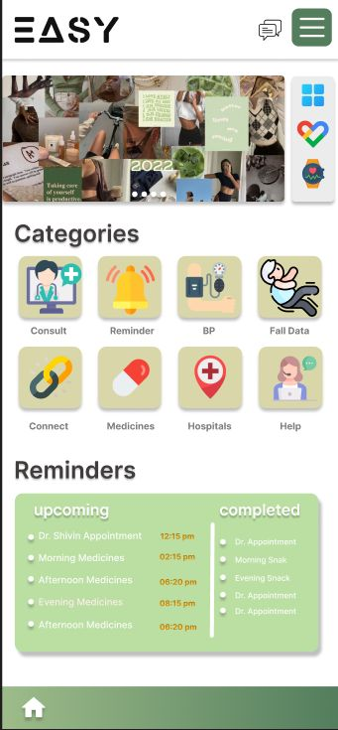
Proposed Solution
🧩 Key Features and Functionalities
Vitals Monitoring Dashboard
Manual input fields and automatic data (via IoT sensors) for heart rate, body temperature, and BP.
Data visualizations to help track trends over time.
Medicines Tracker
Maintain records of current medications, dosages, and refill alerts.
Link medicine intake with reminders and vitals monitoring.
Caregiver Connect
Share user health data with selected caregivers for enhanced communication.
Alerts sent to caregivers in case of missed vitals or detected emergencies.
Support & Help
Includes FAQs, chatbot support (future), and guides for app usage.
Prototype’s Interface

Slide 11
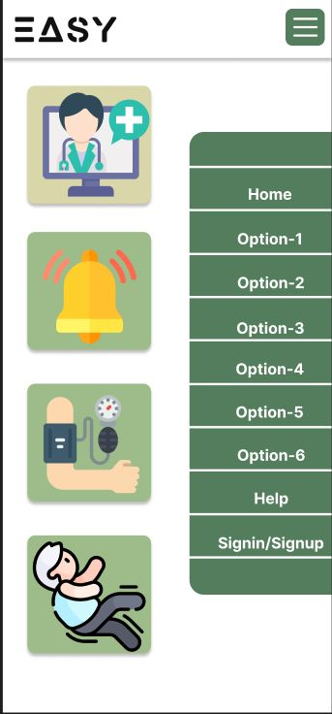
Proposed Solution
🧩 Key Features and Functionalities
Fall Detection System (via IoT accelerometer)
Alerts caregivers or doctors in case of abnormal movement or fall.
Adds a layer of emergency readiness especially for elderly users.
Smart Reminder System
Daily reminders for medication, appointments, meals, and custom health tasks.
Real-time notifications and status updates for completed and pending tasks.
Doctor & Hospital Directory (Consult and Hospitals sections)
Access hospital and clinic info quickly.
Contact or schedule appointments with nearby professionals.
Prototype’s Interface

Slide 12

Proposed Solution
- What makes your solution unique?
🌠 Vision-Driven Innovation at the Core The most unique feature of our project is its clear, compassionate vision—to democratize healthcare through smart, accessible, and affordable solutions. It’s not just a product, but a mission to ensure no one—especially the elderly—is left behind due to tech barriers or financial limitations.
🔗 All-in-One Health Ecosystem Combines vitals tracking, reminders, caregiver connectivity, and emergency detection—eliminating the need for multiple apps/devices.
💡 IoT Integration as a Differentiator Unlike most reminder-only apps, our system optionally integrates real-world sensor data through a prototype device—opening doors to autonomous health monitoring.
💰 Affordability-First Approach Designed using open-source frameworks and low-cost hardware (for the IoT unit), making it scalable and economically viable for real users.
🧓 Senior-Friendly Interface High contrast design, large icons, minimal text, and categorized menus ensure ease-of-use for elderly or visually impaired users.
🛠️ Modular & Scalable Architecture Frontend, backend, and hardware modules are decoupled—allowing future upgrades, such as AI-based anomaly detection or wearable integration.
🌐 Cross-Platform Access Can be accessed via any web browser—no need for app installs—ensuring reach across devices (PCs, tablets, phones).

Slide 13
Technical Approach
- Tools, technologies, and frameworks to be used
- Hardware/Software details (if applicable)
- Workflow or architecture diagram (if relevant)

Slide 14
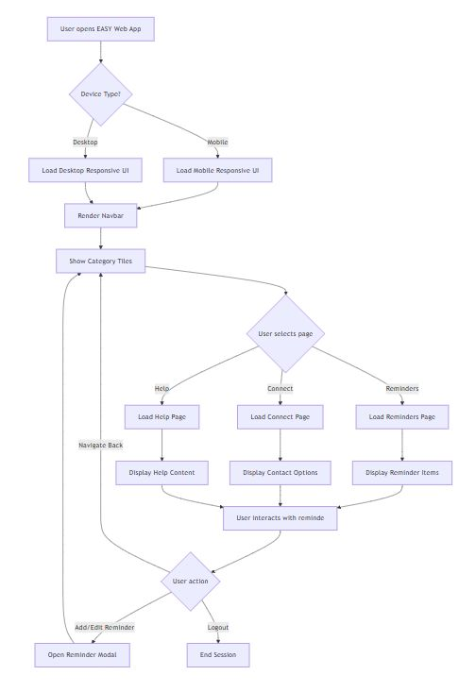
Technical Approach
- Tools, technologies, and frameworks to be used
1. Web Application (Primary System)
Our core platform is a responsive web application named EASY, designed for both mobile and desktop usage—particularly accessible for elderly users with simple navigation and large UI elements.
📌 Frontend Stack
React.js: SPA architecture with modular components (e.g., Navbar, Category Tiles, Reminder Items).
React Router DOM: Handles dynamic routing for pages like Reminders, Connect, Help, etc.
Tailwind CSS / CSS Modules: Used for accessible, clean styling with emphasis on minimalism, large touch targets, and readability.

Slide 15
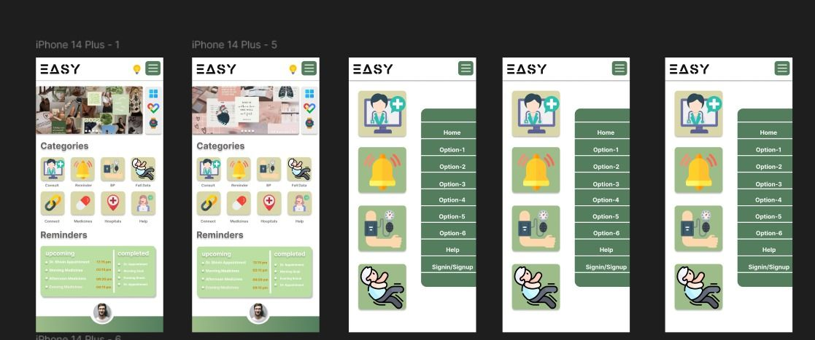
Technical Approach
-🧩 Key Features and Functionalities
Front-End Architecture of EASY: Digital Health Assistant
Frontend–Overview (In Progress)

Slide 16
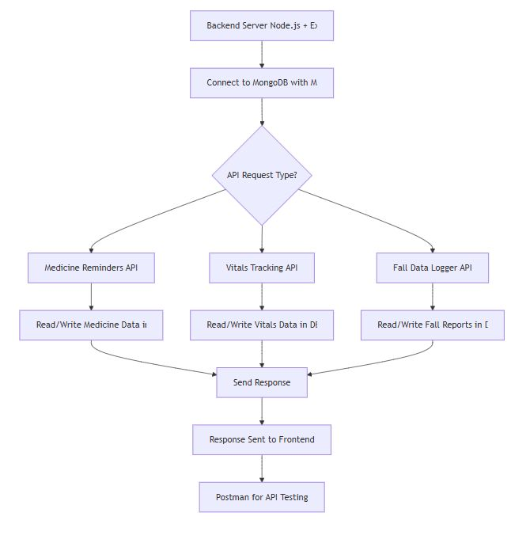
Technical Approach
- Tools, technologies, and frameworks to be used
🧠 Backend
Node.js + Express.js – These handle the logic of the app and connect it to the database.
MongoDB + Mongoose – Used to store data like medicine schedules, vitals, and fall reports.
Postman – Used to test APIs during development.
Backend Features:
Medicine Reminder System – Lets users add and view medicine reminders by time.
Vitals Tracking Module – For tracking blood pressure, sugar, and oxygen levels.
Fall Data Logger – Allows users to record any fall incidents.
Organized APIs – Different API routes for different features (like /reminders, /vitals, /medicines).

Slide 17
Technical Approach
-🧩 Key Features and Functionalities
EASY: Web-App
Backend Demonstration of Core Health Modules
(In Progress)
(Vitals, Reminders & Consult APIs)

Slide 18
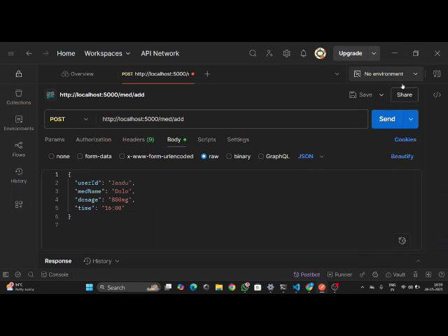
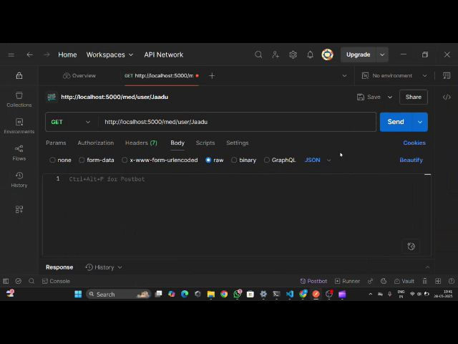
Technical Approach
Click To Play The Desired Demo Video
Medical Reminder Upload Feature
Medical Reminder Get User Details Feature
Backend Demonstration

Slide 19
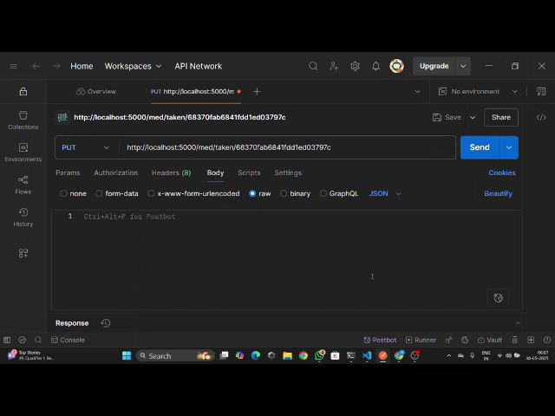
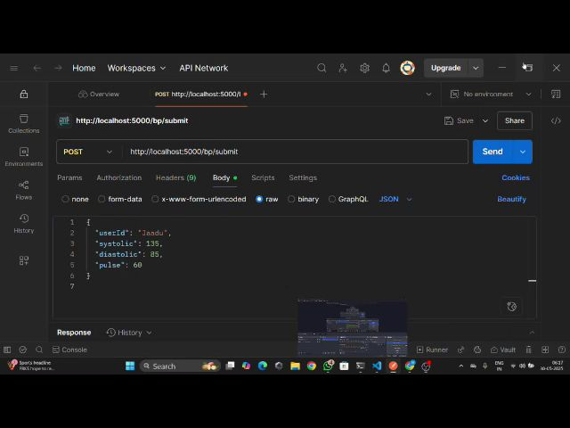
Technical Approach
Click To Play The Desired Demo Video
Medical Reminder Marked As Taken Feature
Blood Pressure And Pulse Adding Feature
Backend Demonstration

Slide 20
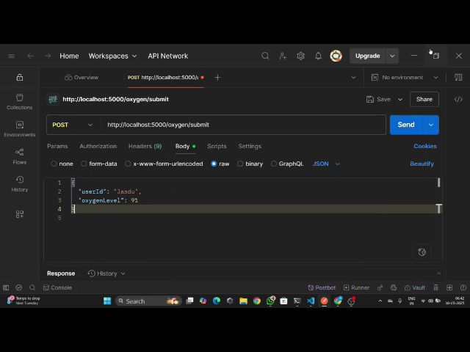
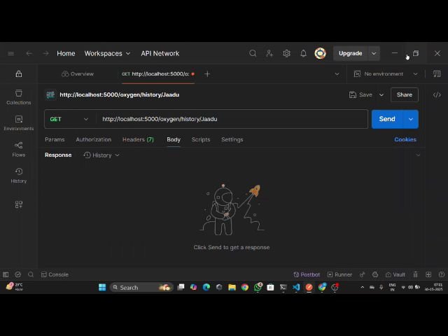
Technical Approach
Click To Play The Desired Demo Video
Oxygen Readings Adding Feature
Get Oxygen Reading From database Feature
Backend Demonstration

Slide 21
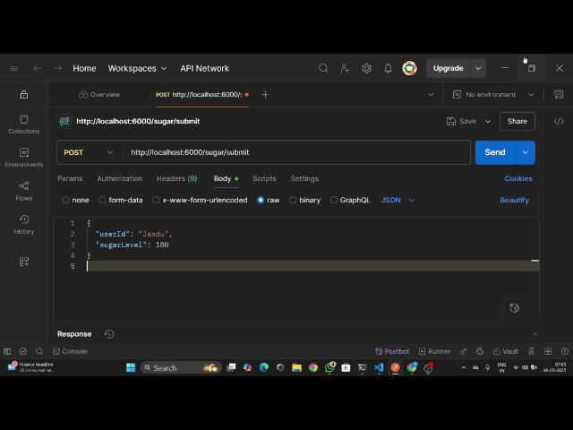
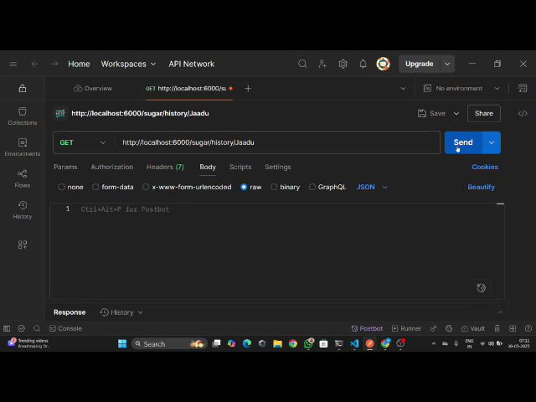
Technical Approach
Click To Play The Desired Demo Video
Sugar Readings Save Feature With Suggestions Based On Readings
Get Sugar Reading From Database Feature
Backend Demonstration

Slide 22
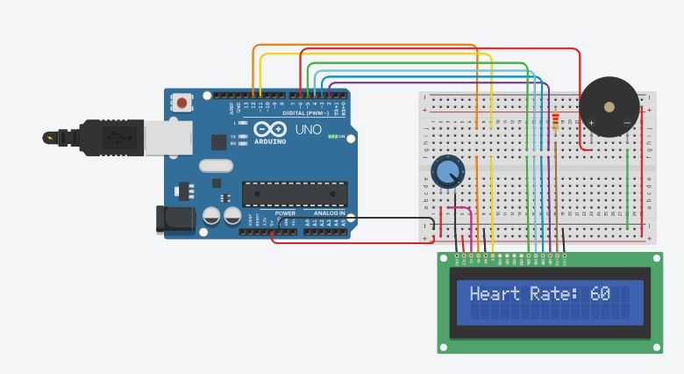
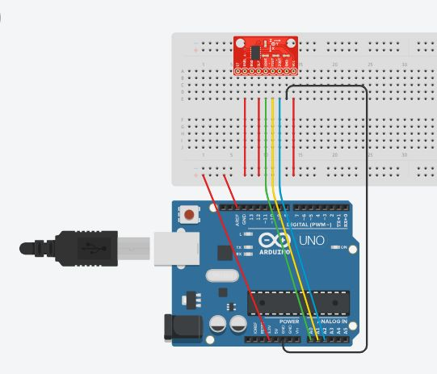
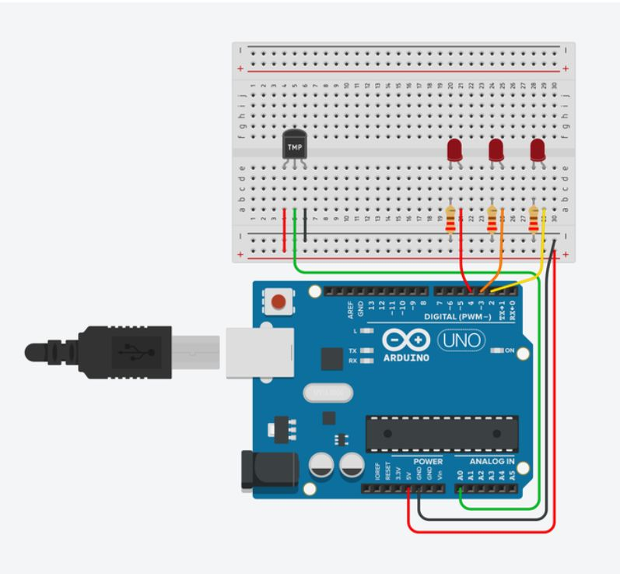
Technical Approach
- Tools, technologies, and frameworks to be used
Individual Test-Prototypes for each sensor. Yet to be integrated in one final machine. Work in Progress
IoT Device (Optional Extension):
Microcontroller:
ESP32 Dev Board chosen for its built-in Wi-Fi enabling wireless data communication
Sensors:
MAX30100/102: Heart rate and SpO₂ measurement
MPU6050: Accelerometer and Gyroscope for motion sensing and fall detection
LM35/DS18B20: Body temperature measurement
Additional Components:
LEDs and buzzer for immediate local alerts (visual and audio)
Breadboard and jumper wires for prototyping
Powered by USB or optional power bank for portability
Functionality:
Real-time data capture and wireless transmission to backend server
Users can choose to input vitals manually in the app OR use this device for accurate, continuous monitoring
Device supports emergency fall detection alerts and health monitoring even when offline (with local alerts)
Flexibility:
IoT device is optional and designed to complement the app
Enables users without the device to still use app fully with manual data entry
Heart beat Sensor
Accelerometer
Temperature Sensor

Slide 23
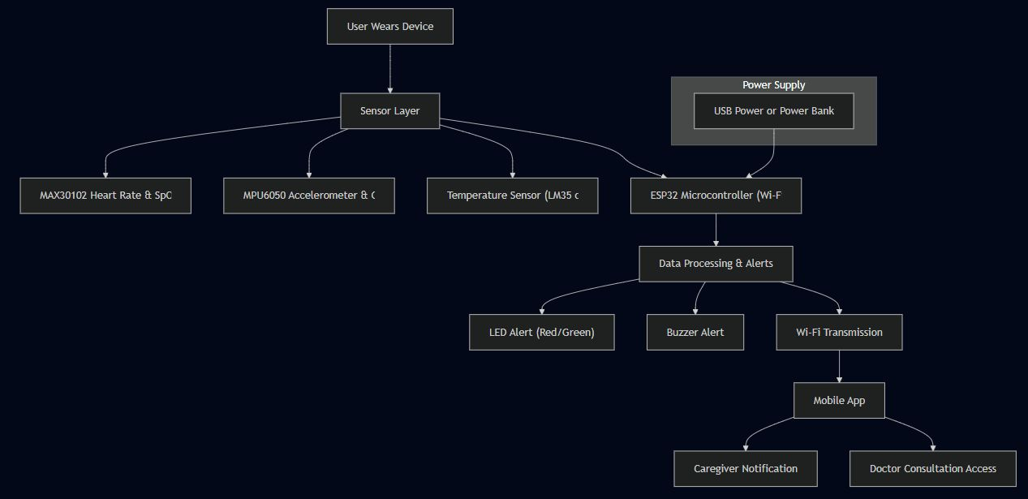
Technical Approach
IOT Device Architecture (In Progress)

Slide 24
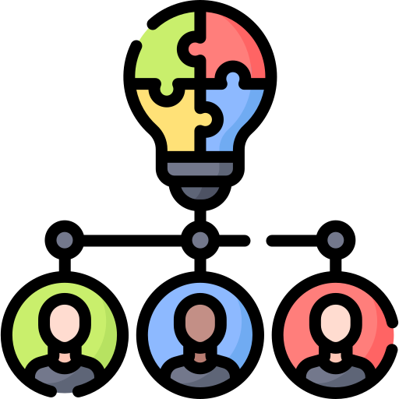
Technical Approach
-Hardware/Software Integration and Workflow
User Interface:
Users access the EASY app via any device through a web browser.
The interface is intuitive and designed for all age groups, especially the elderly.
Users can manually enter health vitals, or—if they opt for it—connect an IoT device for automatic updates.
Manual entry ensures full app functionality even without the device.
Data Flow:
Frontend (React.js) fetches and displays health data by interacting with backend APIs.
Backend (Node.js + MongoDB) stores, updates, and secures user health data.
Medication reminders and vitals history are processed and displayed seamlessly.
Future scope includes email/SMS alerts for medication and critical conditions.
IoT Data Transmission (Optional Feature):
The ESP32-based device captures real-time sensor data (SpO₂, heart rate, temperature, motion).
Data is transmitted via Wi-Fi to backend APIs.
Backend logs this data in the database and flags anomalies for alert generation.
This hardware integration is currently optional—users can opt to purchase the device if they prefer automatic real-time monitoring.
Emergency Handling (IoT-only capability):
If the device is in use, it monitors for falls using motion sensors (MPU6050).
A buzzer and LED are triggered immediately for local alerting.
This data is also sent to the backend, allowing potential caregiver alerts (future enhancement).
Note: While the IoT device adds significant value through automation and real-time monitoring, it is currently a secondary focus. The primary offering remains the standalone web app.
If the IoT integration proves successful, we envision developing a full-fledged hardware-software ecosystem to scale this model in real-world healthcare settings.

Slide 25
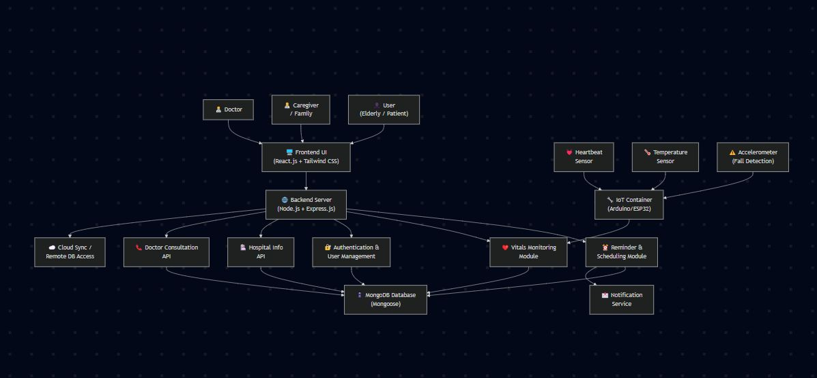
Technical Approach
System Design Architecture of EASY: Digital Health Assistant
Frontend–Backend–IoT Integration Overview

Slide 26
Feasibility and Impact
- How feasible is your solution (time, cost, resources)?
- Expected impact or benefits of your solution

Slide 27
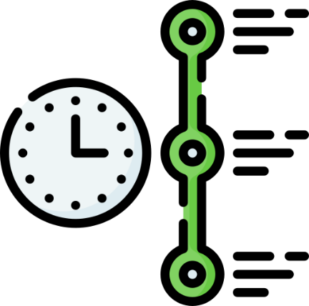

Feasibility and Impact
- How feasible is your solution (time, cost, resources)?
Hackathon Timeline: Total Duration – 3 months Time Remaining – 2 months
Completed (First Month):
Web app core frontend (React.js + modular UI)
Backend structure (Node.js + MongoDB + REST APIs)
MVP-level features like medication reminders, vitals entry, and dashboard layout
Next 2 Months (Hackathon Goal):
Finish full integration of backend with frontend
Finalize medication, vitals tracking, and appointment management
Basic real-time sync with optional IoT device
UI/UX polish, responsiveness testing, and bug fixing
Beyond Hackathon (Future Scope):
AI-powered predictive monitoring (analyzing trends in vitals)
AI chatbot for elderly-friendly communication
Advanced caregiver/patient interaction modules
Cloud analytics for long-term health data trends
⏳ Estimated total time beyond hackathon: 2–4 additional months
🕒 TIME

Slide 28
Feasibility and Impact
- How feasible is your solution (time, cost, resources)?
✅ Free Tier for All (Until Complete Build):
The web app and features will be free for all users during development and early testing.
Even the IoT device will be provided free for testing, based on availability and volunteer users.
Only those who choose to continue using the IoT device long-term may opt to purchase the premium version once released.
Web app + IoT testing will remain free during MVP and pilot runs
The IoT device will be given freely for testing. Users may purchase it later only if they wish to continue long-term
🎯 Goal: Minimum Software Cost
We aim to keep the platform free or very low-cost, especially for elderly users
Ad-supported option may be used to subsidize costs for needy users
Voluntary donation model will allow those who can afford to support the platform
🕒 COST

Slide 29
Feasibility and Impact
- How feasible is your solution (time, cost, resources)?
Web App (with or without IoT):
Item | Approx. Monthly Cost
Hosting (Vercel/Render) | ₹400–₹700
MongoDB Atlas (Free Tier) | ₹0
External APIs (Optional) | ₹200–₹500
Domain & SSL (Optional) | ₹500–₹800 yearly
Software Cost (Basic) | ₹600–₹1,200/month
🕒 COST
IoT Device (Optional per user):
Component Bundle | Cost (INR)
ESP32 + Sensors + Wiring | ₹1,200–₹1,600
Power Supply (Optional) | ₹400–₹600
Hardware Cost/User | ₹1,200–₹2,000 one-time

Slide 30
Feasibility and Impact
- How feasible is your solution (time, cost, resources)?
What We Have: ✅ Tech stack already selected and implemented (React.js, Node.js, MongoDB, Express) ✅ Working API structure + local testing via Postman ✅ Working IoT prototype (ESP32, MAX30100, MPU6050, LM35) ✅ Modular frontend and backend codebase ✅ Real-world research and user personas created
What We’ll Need:
Hosting + CI/CD pipeline
Domain and deployment setup
Feedback and testing from real users
Volunteer testers for IoT hardware
AI/ML tools in the post-MVP phase
⚙️ RESOURCES
Scalability Plan:
Build React Native mobile app
Enable Bluetooth sync for wearable devices
Add cloud analytics and caregiver sync options

Slide 31
Feasibility and Impact
-Expected impact or benefits of your solution
❤️ 1. Human-Centered Design
Created with empathy, especially for the elderly, chronically ill, and remote-living individuals.
The user interface is minimalistic, mobile-friendly, and accessible even to non-tech-savvy users.
⚖️ 2. Accessibility vs. Affordability
Fills a critical market gap:
Not as unaffordable as Apple/Smart watches (~₹30,000+)
Not as unreliable as ultra-cheap wearables (~₹500–₹800).
Offers the best of both — simple, powerful, and affordable
📶 3. Flexible Use Cases
Without IoT Device:
Manual data entry
Suitable for users with limited access to hardware
Very low or zero cost
With IoT Device:
Real-time, accurate, and automated health tracking
Falls under preventive healthcare
Adds convenience for families and caregivers
🚀 4. Scalable for Institutions & NGOs
Easily adaptable for:
Elder homes
Clinics and PHCs
Health NGO programs
Government health missions (e.g., Ayushman Bharat)
💡 5. Long-Term Vision Impact
If the IoT model succeeds in small trials:
We envision full-scale software-hardware synergy
Could inspire open-source health device kits for rural India
Empowers tech-for-good ecosystems in healthcare

Slide 32
Timeline and Goals
- Plan of action for the hackathon
- Key milestones and deliverables
- Final objectives

Slide 33

Timeline and Goals
- Plan of action for the hackathon
Month 1 (Completed - May) ✅ Finalized problem statement, tech stack, and core vision ✅ Divided responsibilities across team members (frontend, backend, IoT) ✅ Created a working prototype and completed Round 1 documentation (PPT)
Month 2 (June) 🔹 Develop complete MVP (Minimum Viable Product) 🔹 Integrate core frontend & backend features (medication reminder, vitals input, data dashboard) 🔹 Complete IoT prototype testing (ESP32 + sensors + NodeMCU) 🔹 Prepare and submit for Round 2 by 15th June
Month 3 (July) 🔸 Refine UI/UX for accessibility (especially for elderly users) 🔸 Start AI module prototyping (fall prediction, chatbot logic – future scope) 🔸 Perform user testing & feedback (demo with test users) 🔸 Present offline working prototype on 13th July (Round 3)

Slide 34

Timeline and Goals
- Plan of action for the hackathon
Date | Milestone | Status
31st May 2025 | Round 1 Submission (Vision + Prototype PPT) | ✅ Complete
15th June 2025 | Round 2 (Functional MVP + UI Testing) | 🔄 Upcoming
13th July 2025 | Round 3 Offline (Demo, Final Presentation) | 🔄 Upcoming
July+ (Post-event) | Open Testing + Public Feedback | 🔜 Planned
- Final objectives
✅ Deliver a functioning health app with essential features
✅ Allow optional IoT device for real-time vitals tracking
✅ Build an affordable, accessible solution for all, especially the elderly
✅ Make the base version free for all users with optional upgrades
🔮 Lay foundation for future AI integration (prediction + chatbots)

Slide 35
Conclusion
- Summary of your idea and its importance
- What do you aim to achieve?
- Why should your idea be considered?

Slide 36

Conclusion
- Summary of your idea and its importance
“EASY is not just an app—it’s a mission.”
Born from empathy and designed with purpose, EASY aims to simplify daily healthcare routines and make them universally accessible. With features like medication reminders, vitals tracking, doctor access, and emergency alerts, it supports individuals who need it the most—especially the elderly.
By blending technology with compassion, we ensure that no one is left behind—not due to age, affordability, or digital barriers.

Slide 37

Conclusion
-What do you aim to achieve?
Build a platform that’s easy enough for elders, powerful enough for real impact
Provide timely, affordable, and reliable healthcare assistance to all
Create a space where users feel seen, supported, and safe
Make healthcare monitoring truly inclusive and accessible
Reduce preventable health risks through early detection and timely care
Build a product that is simple enough for elders and powerful enough for real impact
Promote a vision-first approach that balances technology with empathy

Slide 38

Conclusion
- Why should your idea be considered?
Uniquely Vision-Driven: Our mission to democratize healthcare for all—especially the elderly—makes us stand out
Technically Feasible: We’ve already built the foundation (frontend, backend, IoT), and we’re ready to scale
Affordable + Scalable: With minimal costs, optional hardware, and a donation/ad-supported model, we ensure maximum accessibility
Future-Ready: With plans to integrate AI prediction and chatbots, we’re not just solving today’s problems—we’re building for tomorrow

Slide 39

Thank You For Your Time

